Slide 1
Personal Identity
Introduction to Philosophy
Philosophy 100
Class 11

Slide 2
Overview
Three main questions we will consider:
Who am I?
What am I? What is a person? What counts as evidence towards and answer to this question?
What is persistence and how does something persist over time?
Why does personal identity matter, if at all?

Slide 3

A Warm Up – Identity Over Time
A Classical Example: The Ship of Theseus
Imagine the flagship of a nation’s navy—call it SOT. SOT has been damaged and fixed so many times that all of its wood, metal, and sails have been incrementally replaced. Is this ship still SOT, or is it a different ship?
The Conundrum:
If a changing thing really changes, there can't literally be one and the same thing before and after the change.
However, if there isn't literally one and the same thing before and after the change, then no thing has really undergone any change.

Slide 4




Personal Identity
This is a more focused question on the identity problem.
What makes me the same me over the course of a lifetime?

Slide 5
Personal Identity
Identity is the relationship that facilitates the existence of x at one time continuing to x’s existence at another time.
Personhood cannot be divided, or consist of parts.
Personal identity, then, implies the continued existence of that indivisible thing which I call myself.
Personal identity is neither action, nor thoughts, nor feelings; personal identity is all of these things in successive existence in myself.

Slide 6
What are the necessary and sufficient conditions for one to persist?
Psychological Continuity:
Memory theory
Brute-Physical:
Animalism
Two views
Minimally, you are your consciousness. A psychological relation through time is either necessary or sufficient or both for personal identity through time.
You are your nothing more than your body. Whatever physical stuff you’re made of is what and who you are. There is no necessary psychological continuity.

Slide 7
John Locke’s Psychological Continuity Theory of Personal Identity
Locke suggests that in order to answer the question of personal identity, we need an account of the person.
His response: A person is an intelligent being that can reason, reflect, and self-reflect on itself as itself across space and time—all of this is what we’d call consciousness.
In consciousness alone is personal identity found.
Locke considers the obvious response to his view:
What about when we lose memories or lose consciousness?
His response:
It may be that we’re different persons at different time—so be it. This conclusion would actually make sense of some of the ways that we already think. Like “She’s not herself today.” Or “John lost his mind; that really wasn’t like him at all.”

Slide 8
Locke: Our Psychology Determines our Identity
We are not our bodies
We are not souls
Despite what the substance that houses our consciousness is made up of, as long as there is the same consciousness, there is the same person. Different bodies are just like different sets of clothes.
Some support for this: If a part of our body is removed, we are still the same person. We maybe concerned for our body parts, but they can be changed without a change in our own identity.
The same soul will not unify a person over time unless that soul is connected consciously.
Employ whatever substance you like, as long as the self is reflective and memorial, the self remains the same. If one can recall—in the robust sense of recall—Caesar crossing the Rubicon, the Battle of Waterloo, and yesterday’s lunch offerings at the University Center, then one is the same person in each situation.

Slide 9
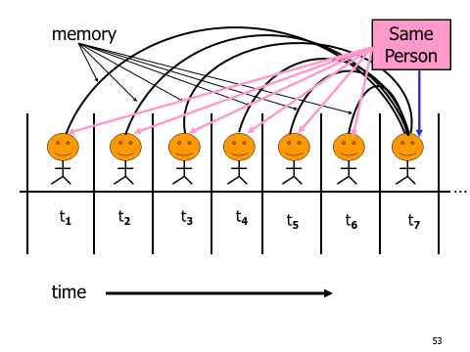

Slide 10
Reid’s Retort to Locke
There’s a strange consequence if we base our identity off of psychological continuity—it can extend to more than one being; two or twenty beings might be the same person; a person may be, and at the same time not be, the person that did a particular action.
The Case of the Flogged General
Flogged boy
Thief private
Old General
The private recalls being flogged as a child, but the general doesn’t remember being flogged as a child but does remember stealing the standard as a private.
How many identities are there here? On Locke’s view, the private is both the general and the school boy, but the school boy and the general are not the same person!

Slide 11
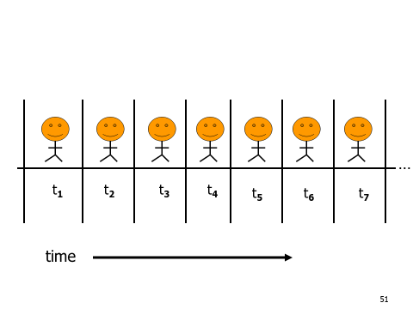

Flogged Boy
Thief Private
Old General

Slide 12
Same Person
Not the Same Person
Same Person
Flogged Boy
Thief Private
Old General

Slide 13
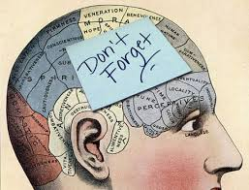
Knowing what personal identity is, then, how can we know that there is such a self?
Memory!
Memory provides us with conclusive evidence that we are the same person now as we were earlier.
So although succession of events are individual and not connected, I have sufficient evidence from my own person that they were experienced by me.
Other evidence exists also—pictures, record of family history and lineage, etc.
We may not remember any of these things, but they count as evidence in favour of our own continued existence.
This view admits of great change in who a person is over time.

Slide 14
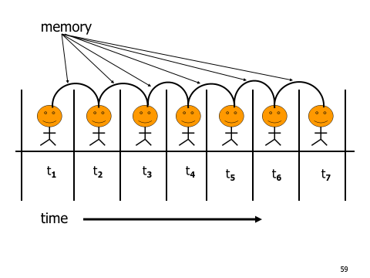

Slide 15
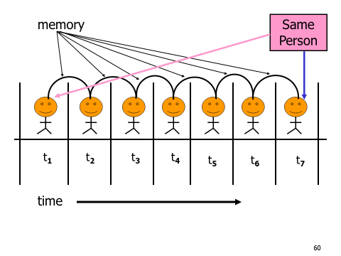
= Evidence for this →

Slide 16
Reid’s View
“It may be observed...that it is not my remembering any action of mine that makes me be the person who did it. This remembrance makes me to know assuredly that I did it; but I might have done it though I do not remember it.”
The objects of sense are not perfect. They are based on similarity. Memory is not like this. It gives undoubted certainty to our own continuity.

Slide 17
But we’re not concerned with mere evidence; we’re concerned with identity!
There’s a difference between a metaphysical identity claim and the epistemic claim for how we know our own identities.

Slide 18
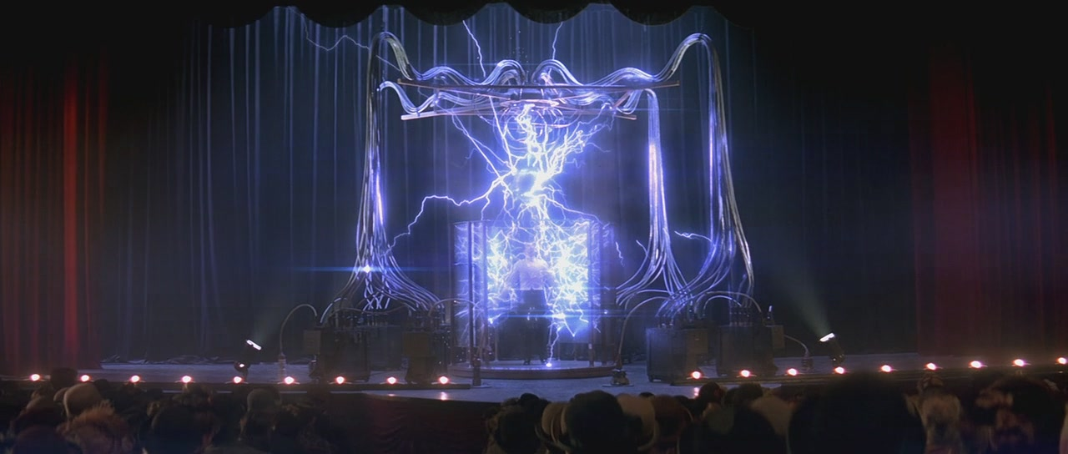
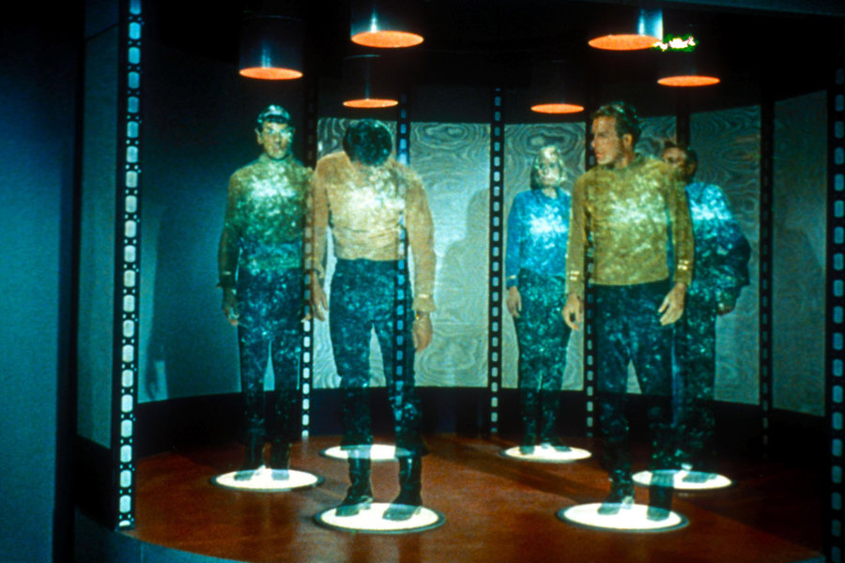
Challenges to the Psychology Theory
Replicator
Teleporter

Slide 19
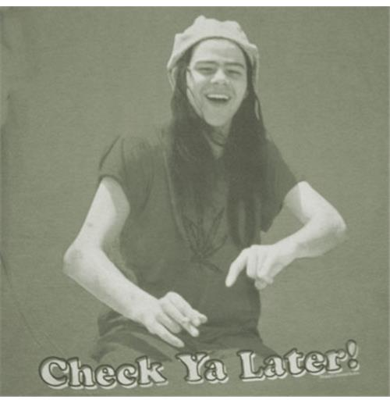

Slide 20
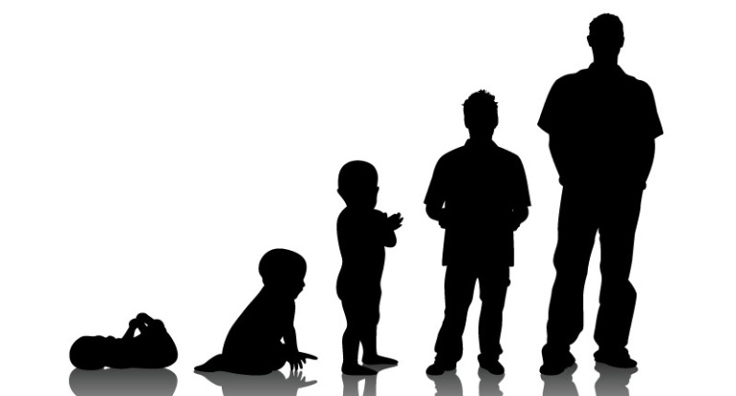
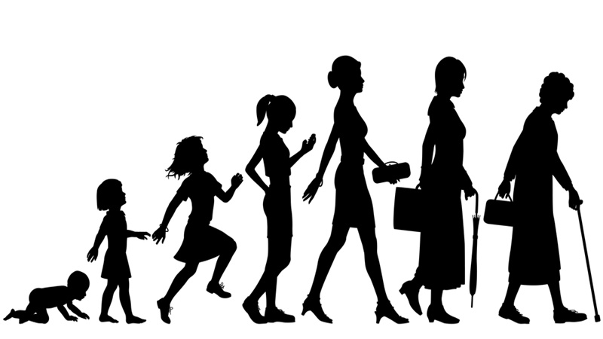
Two Accounts of Personal Identity
Organism-Based “Body” View (OV) (Animalism)
Memory-based “Psychology” view (PV)
S is that same person at t1…tn iff S has bodily continuity at t1…tn.
You are nothing more than your body.
S is the same person at t1...tn iff S has psychological continuity at t1...tn.
You are nothing more than your psychology

Slide 21

The Transplant
Suppose you and another person have received brain/body transplants.
Two ways of describing the story:
You wake up and discover that you have a new body—a body that is completely foreign to you.
You wake up and have a bunch of false memories and beliefs about yourself—beliefs that your appearance was a certain way or that your

Slide 22
Brain/Body Transplant
OV
PV
The two participants are merely schizophrenic or delusional, but they remain the same respective persons despite the swapped psychology.
The transplanted brains would result in each individual taking on an entirely new body, but remain the same people in virtue of their continuous or connected psychology.

Slide 23
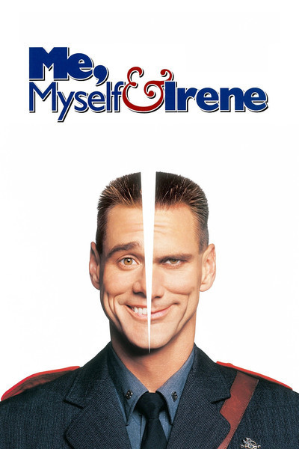
Multiple Personality Disorder
Suppose someone has two personalities. These personalities are aware of each other, but cannot communicate and are not present at the same time. Nonetheless, they share the same body.

Slide 24
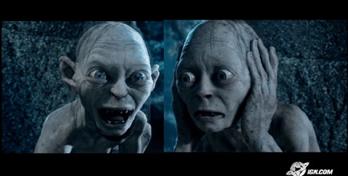
Dissociative Identity Dissorder
OV
PV
Same person with different personalities.
Different persons sharing one organism.

Slide 25
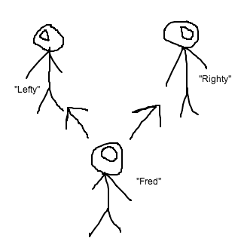
Fission: One Brain Two Bodies
Suppose Fred has brain surgery that splits his brain’s hemispheres into two separate pieces. Then one of the hemispheres is transplanted into another body. Which one is Fred?

Slide 26
Brain Fission
OV
PV
Two different people sharing the same psychological past up to the point of division—prior to which they were both Fred in virtue of the being one organism but now they’re different people.
They were both Fred up to the point of division in virtue of their shared psychology at the time; the point at which their respective psychologies diverged they became new persons.

Slide 27
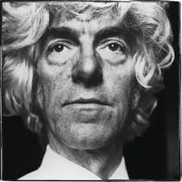
Derek Parfit (1942 – 2017)
British Philosopher
Focused on personal identity, ethics, metaphysics, and epistemology
Parfit argues that in all of the above cases, the thing that is triggering our intuitions one way or the other isn’t personal identity—i.e. whether or not I exist or cease to exist in the above cases. Rather, whether or not it matters to me in the above cases.

Slide 28
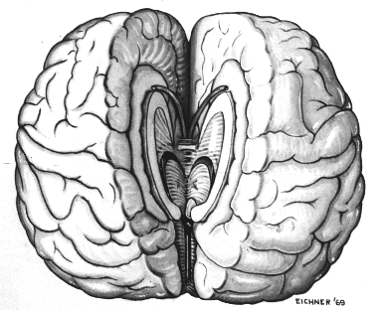
The Unimportance of Divided Psychology
If two people come out after a split brain operation both cannot be me, but this shouldn’t matter to me because nothing is missing from a case where I simply lose half a hemisphere.

Slide 29
The Unimportance of Body Swapping
Regardless of who the person would be afterwards, in a case of life or death brain swap, the resulting person would still believe that were the same person now as they were prior to the brain swap.
The PV would agree with this, but for different reasons—they’d agree because they think that person just is the same person. The OV would disagree. Parfit says: doesn’t matter, just so long as P1 at t1 believes she is the same person at t2. What matters is the outcome, not the identity.

Slide 30
What matters?
“We should revise our view about identity over time. What matters isn’t that there will be someone alive who will be me. It is rather that there will be at least one living person who will be psychologically continuous with me as I am now, and/or who has enough of my brain. When there is one such person, s/he can be described as me. When there will be two such people, we cannot claim that each will be me.”
What matters is that whatever persists through time has the right relation between some conscious person in the future and myself. But it doesn’t need to be me to matter.

